Slide 1

  Outlet Master – DMS-NG: User
  Guide
  Comprehensive Walkthrough of Outlet Profiling Version 1.2
www.centegytechnologies.com
contact@centegytechnologies.com

Slide 2
  Outline
Below are the list of topics covered in this guide.
01.
Outlet Master Introduction and Workflow
02.
Outlet Profile Creation
03.
Outlet Profile Approval
04.
Change Track Outlet Profile
05.
Change Track Outlet Operative Info
06.
Change Track Outlet Document
07.
Analysis Classification-Outlet
08.
Outlet Status
09.
Outlet Profile View
10.
Outlet Change Track Excel
11.
Outlet Creation Upload

Slide 3
Introduction and Process Flow
Setting up outlet profiles within the Sales and Distribution Management System involves establishing detailed information about sales outlets. This process can be initiated by company/global-level users or distributors associated with specific companies and they can update or modify the information related to the outlets later on. Note that the distributors requires approval from the company users to activate outlets. Once set up will be done, these profiles provide a foundation for targeted marketing, efficient sales strategies and logistical planning.
1
3
5
Outlet Profile Creation
Change Track Outlet Profile
Change Track Outlet Document
Create new outlet profiles from scratch. Input all necessary data to establish a complete outlet record.
Modify specific attributes of approved outlets. Users can update outlet details to reflect the most current information.
Modify documents of approved outlets. Users can update outlet documents as per the current requirements to ensure all relevant documents are up to date and accurate.
Start
2
4
6
Outlet Approval II
Change Track Outlet Operative Info
Analysis Classification - Outlets
Users approve outlet profiles using the Outlet Approval II interface.
Modify operative information of approved outlets. Users can update details related to outlet operations as needed.
Categorize outlets based on specific classification criteria. Provides both grouped and detailed views for better analysis.

Slide 4
Introduction and Process Flow
7
9
Outlet Status
Outlet Change Track Excel
Check the current status of active outlets. Users can also deactivate outlets when necessary using outlet status interface.
Modify specific attributes of approved outlets. Users can update outlet details to reflect the most current information.
11
Outlet Price
The user can add prices regarding the products of the outlets.
8
10
Outlet Profile View
Outlet Creation Upload
View detailed profiles of outlets within the system. Access all relevant information and attributes of each outlet.
The user can create new outlets in bulk using the provided excel template.

Slide 5
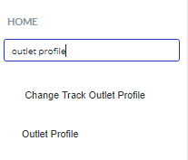
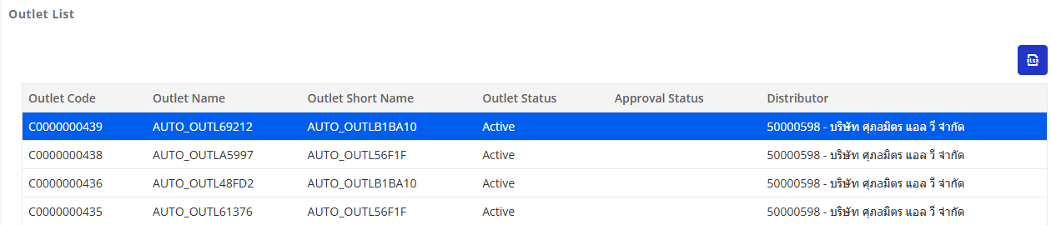
Outlet Profile Creation
Previous Records
The user will utilize this screen for the new outlets profile creation.
1
Search the outlet profile from the search bar. Click on the appeared option.
2
The grid displays all previously created outlets, along with details such as Outlet Code, Outlet Name, Active Status, and other relevant information.

Slide 6
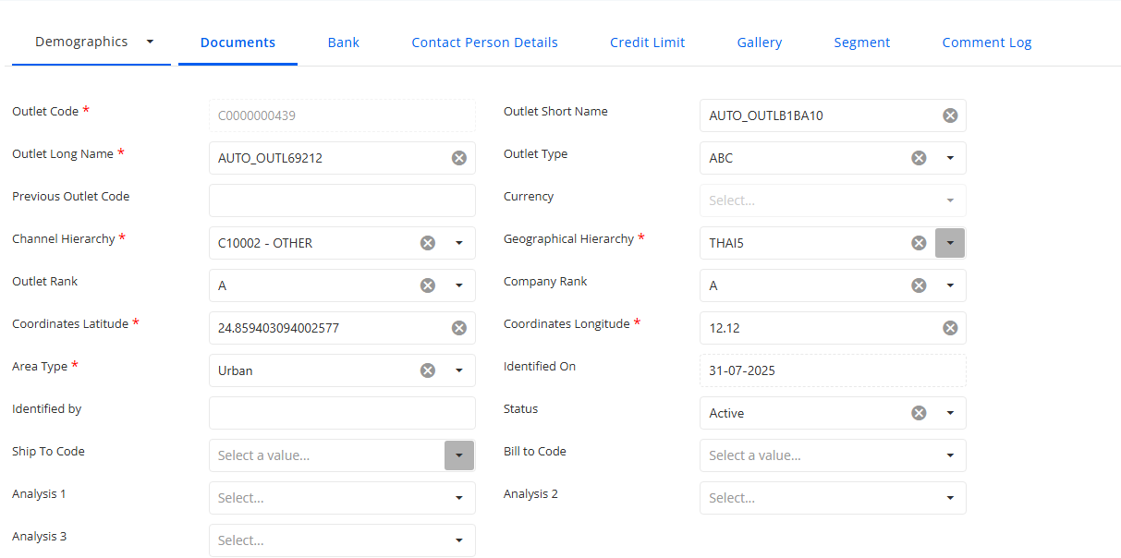
Outlet Profile Creation
Demographics
1
The user can create new outlet by inputting the required fields.
2
Fields Description
Outlet Short Name: In this field, the user is required to enter the brief name of the outlet.
Outlet Type: The "Outlet Type" field is a mandatory selection. Users must choose the outlet type from the dropdown menu, which includes options such as Local Modern Trade, Modern Trade, General Trade, and others.
Currency: Select the currency used for transactions with the outlet.
Geographical Hierarchy: Select the Geographical Hierarchy as per the requirements.
Company Rank/ Outlet Rank: These are the parameters associated with Ranking in the system. These ranks are user defined parameters which the user can create and update. For example Outlet Rank A, Company Rank B etc.
Coordinates Longitude: Add the coordinate longitude for the outlet location.
Identified On: Select the date of the identification for outlets.
Status: This field is auto-generated and shows the status of the outlet as Active or Inactive.
Bill to Code: Billing will be processed at the head office of the outlet. Please choose the designated outlet from the dropdown menu for billing purpose.
Analysis 2: Select the second analysis parameter for the outlet.
2
Fields Description
Outlet Code: The Outlet Code field is auto-generated and disabled in the system.
Outlet Long Name: In this field, the user enters the long name of the outlet.
Previous Outlet Code: Displays the outlet code previously assigned to the outlet, if applicable.
Channel Hierarchy: This field is mandatory, and the last level of the Channel hierarchy will be associated with the outlet. Example: Bakery, Restaurants, Hospitals etc.
Outlet Rank: Select the rank assigned to the outlet based on its business importance or classification.
Coordinates Latitude: Add the coordinate latitude for the outlet location.
Area Type: Select the area type where the outlet is located.
Identified By: Indicate any specific identification criteria for outlets.
Status: Displays the current status of the outlet.
Ship To Code: Enter the code used to identify the outlet as a shipping destination.
Analysis 1: Select the first analysis parameter for the outlet.
Analysis 3: Select the third analysis parameter for the outlet.

Slide 7
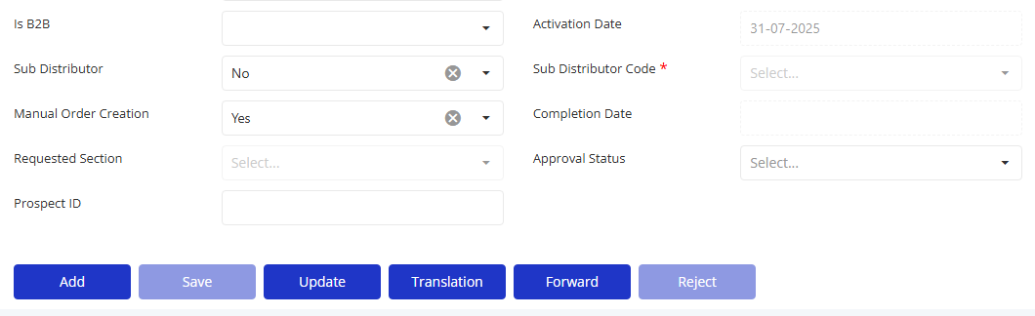
Outlet Profile Creation
Demographics
1
2
Click on the ADD button for the new outlet profile creation.
Fields Description
Is B2B: Indicates whether the outlet operates on a business-to-business (B2B) model.
Activation Date: Specifies the date on which the outlet profile was activated. This is a mandatory field.
Sub Distributor: Identifies the sub distributor associated with the outlet.
Sub Distributor Code: A unique identifier assigned to the sub distributor. This is a mandatory field.
Manual Order Creation: Denotes the capability for the outlet to create orders manually within the system.
Completion Date: Select the date on which the outlet setup or onboarding was completed.
Requested Section: Indicates if the user wishes to map the outlet to any section.
Approval Status: Displays the current approval status of the outlet.
Prospect ID: A unique identifier assigned to a potential customer or business prospect associated with the outlet.

Slide 8
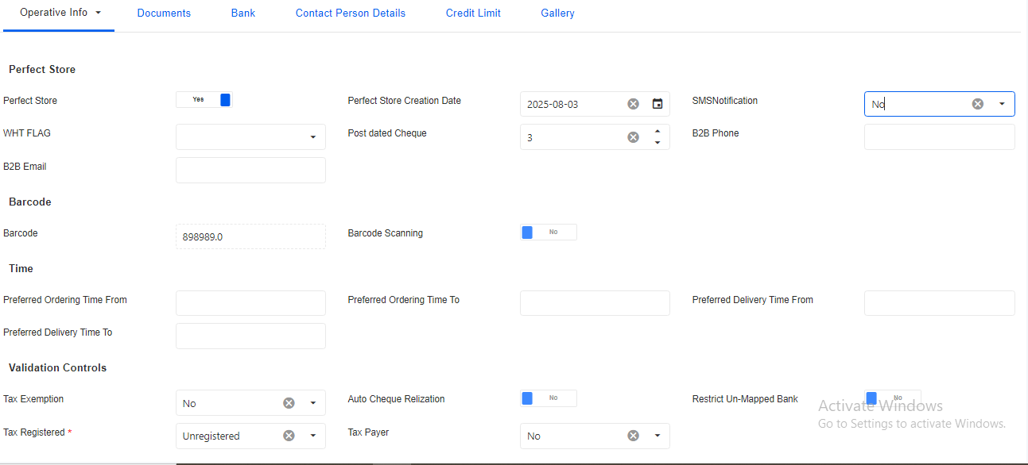
Outlet Profile Creation
Operative Info
2
Operative Info (Fields Description)
Perfect Store: Indicates whether the outlet is classified as a "Perfect Store".
Perfect store Creation Date: Date on which the store was declared as perfect store
SMS Notification: Determines if SMS notifications are enabled for the outlet
WHT FLAG: Indicates whether Withholding Tax (WHT) is applicable to the outlet.
Post-dated Cheque: Specifies if the outlet is allowed to issue post-dated cheques.
B2B Phone: The contact phone number for business-to-business (B2B) communications with the outlet.
B2B Email: The contact email address for business-to-business (B2B) communications with the outlet.
Barcode: A unique barcode assigned to the outlet for identification purposes.
Barcode Scanning: Indicates if barcode scanning is enabled for the outlet.
Auto Tax Invoice: Select auto tax invoice based on the requirements
Tax Registration: Select tax registration based on the requirements
Preferred Order Time From & To : Preferred time to take order form and to
Preferred Delivery Time From & To : Preferred time for delivery of orders.
3
1
Validation Controls
Tax Exemption: Indicates whether the outlet is exempt from taxes.
Auto Cheque Realization: Specifies if the system automatically realizes cheques.
Restrict Un-Mapped Bank: Indicates whether transactions are restricted to mapped banks only.
Tax Registered: Indicates whether the outlet is registered for tax purposes. This is a mandatory field.
Tax Payer: Identifies if the outlet is recognized as a taxpayer.
Operative Info
The Operative Info tab provides comprehensive details regarding tax-related information pertinent to the outlet, encompassing Tax Registration, Tax Exemption, and Auto Tax Invoice.

Slide 9
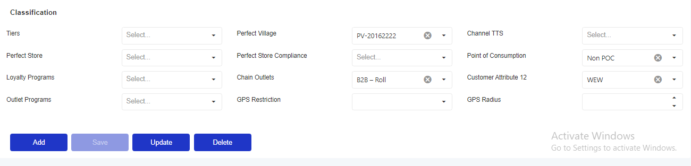
Outlet Profile Creation
Operative Info
1
Pre Requisite
The Analysis Classification-Outlet will be the pre requisite for these attributes. Once classifications are defined, they will appear as options in a dropdown menu in these fields.
2
Classification
Tiers: Specifies the tier level of the outlet.
Perfect Village: Indicates if the outlet is located in a "Perfect Village".
Channel TTS: Denotes the channel's total trade spending (TTS) classification.
Perfect Store Compliance: Measures the compliance of the outlet with "Perfect Store" standards.
Point of Consumption: Indicates the point at which products are consumed by the end customer.
Loyalty Programs: Lists any loyalty programs in which the outlet participates.
Chain Outlets: Specifies if the outlet is part of a chain.
Customer Attribute 12: An additional attribute for further classification of the outlet.
Outlet Programs: Lists the programs in which the outlet is enrolled.
GPS Restriction: Indicates whether the outlet has GPS-based restrictions.
GPS Radius: Defines the allowable GPS radius for the outlet's operations.

Slide 10
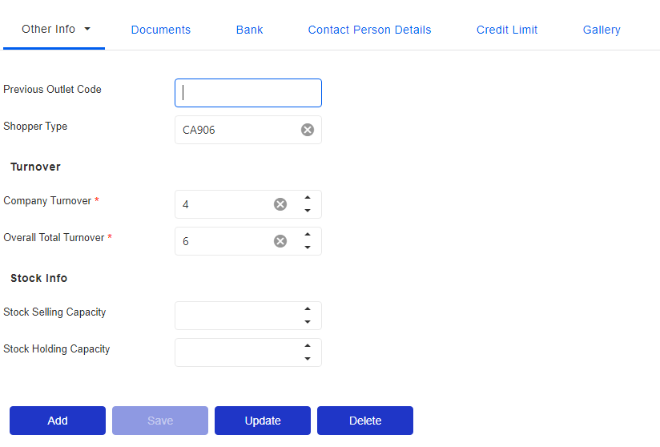
Outlet Profile Creation
Other Info
1
Other Info Fields Description
Previous Outlet Code: The unique identifier assigned to the outlet in a previous system or prior configuration.
Shopper Type: Categorizes the type of shoppers the outlet serves, such as retail customers, wholesale buyers, etc.
Company Turnover: Specifies the total sales revenue generated by the company associated with the outlet. This is a mandatory field.
Overall Total Turnover: Indicates the cumulative total sales revenue of the outlet, including all business activities. This is a mandatory field.
Stock Selling Capacity: The maximum volume of stock the outlet can sell within a given period.
Stock Holding Capacity: The maximum volume of stock the outlet can hold or store at any given time.

Slide 11
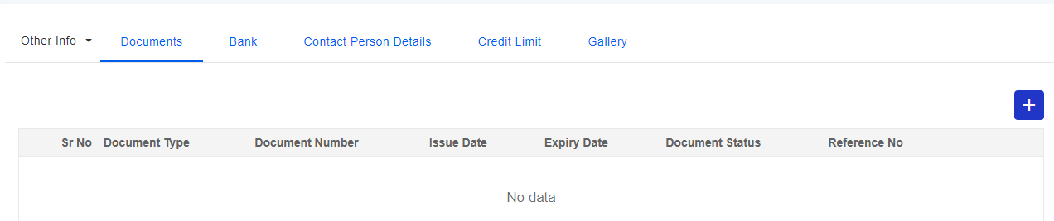
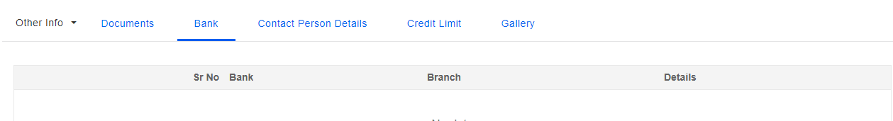
Outlet Profile Creation
Documents & Bank Tabs
1
Document (Fields Description)
Document Number: Input the required document number.
Issue Date: Include the date when the document was issued.
Expiry Date: Specify the expiration date of the document.
Status: Indicate the current status of the document as Active or Inactive.
Reference Number: Incorporate the reference number as applicable.
2
Bank (Fields Description)
Bank: The name of the bank associated with the outlet's financial transactions.
Branch: The specific branch of the bank where the outlet holds its account.
Details: Additional details or notes regarding the bank or branch.

Slide 12
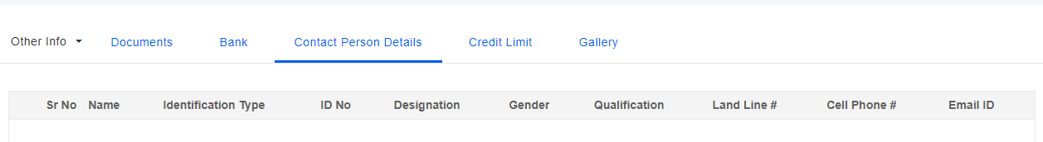
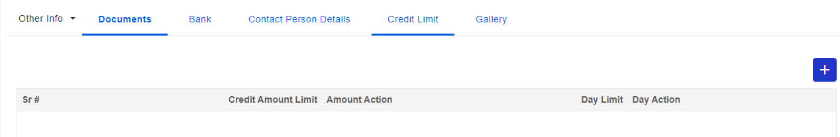
Outlet Profile Creation
Contact Person Details & Credit Limit Tabs
1
2
Contact Person Details Fields Description
Name: The full name of the contact person associated with the outlet.
Identification Type: The type of identification provided by the contact person (e.g., passport, driver's license).
ID No: The identification number corresponding to the identification type.
Designation: The job title or role of the contact person within the organization.
Gender: The gender of the contact person.
Qualification: The educational qualifications or professional certifications of the contact person.
Land Line #: The landline telephone number of the contact person.
Cell Phone #: The mobile phone number of the contact person.
Email ID: The email address of the contact person.
Credit Limit Tab Fields Description
Credit Amount Limit: The maximum amount of credit that can be extended to the outlet.
Amount Action: Specifies the action to be taken when the credit amount limit is reached or exceeded.
Day Limit: The maximum number of days for which credit can be extended to the outlet.
Day Action: Specifies the action to be taken when the credit day limit is reached or exceeded.

Slide 13
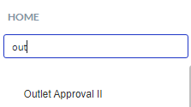
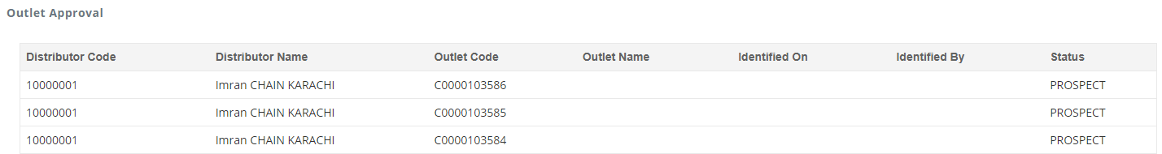
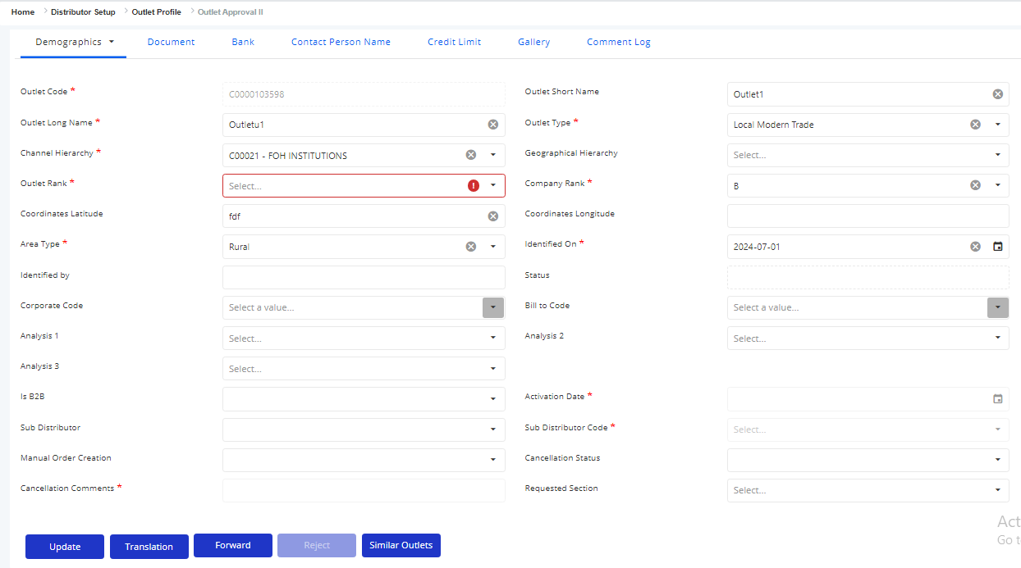
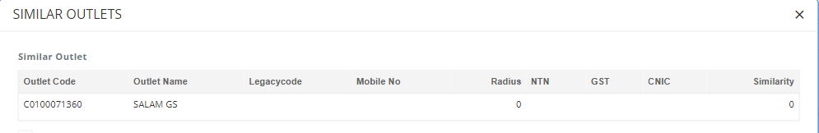
Outlet Approval II
Approval by Company User
The company user will login to the application and follow the approval steps of newly created outlets.
1
Search the outlet approval in the search bar and click on the appeared option.
2
All the created outlets will be displayed in the grid with the PROSPECT status. This means these outlets have in-active status. The user will click on the desired record to approve.
3
On selecting the desired outlet from the grid, the information will be displayed in the fields and user can either approver or reject the request.
4
All those outlets which will be similar in terms of attributes will be appeared in the similar outlets pop-up.

Slide 14
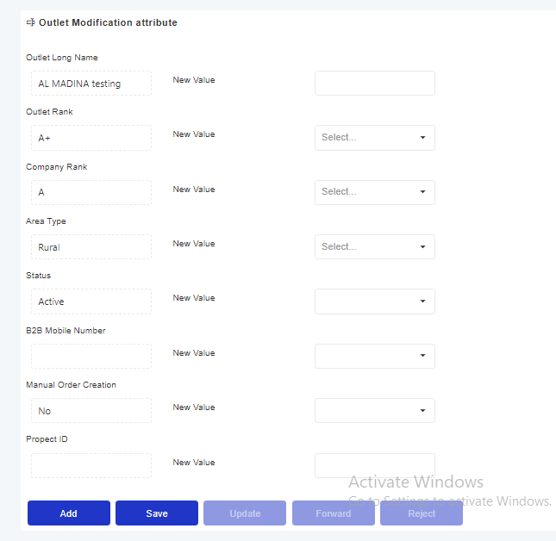
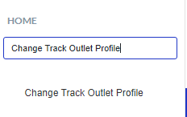
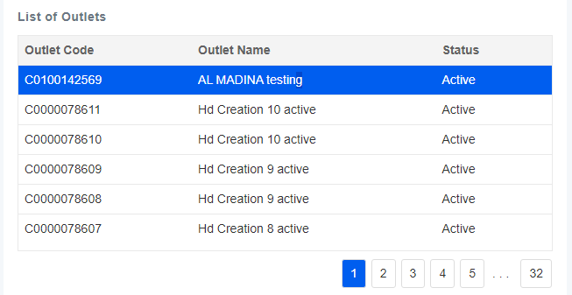
Change Track Outlet Profile
Modify Attributes
In this interface, users have the capability to modify specific attributes of approved outlets.
1
Search Change Track Outlet Profile in the search bar.
2
List of Outlets:
Upon accessing the screen, users will be presented with a comprehensive list of outlets. This list displays all currently approved outlets.
3
Field Descriptions:
Outlet Long Name: The full name of the outlet. Enter the new full name if any changes are required.
Outlet Rank: The rank of the outlet within the distribution network. Modify as needed.
Company Rank: The ranking of the outlet within the company's overall structure. Adjust if necessary.
Area Type: The classification of the area where the outlet is located. Update if applicable.
Status: The current operational status of the outlet. Change if required.
B2B Mobile Number: The business-to-business mobile contact number for the outlet. Update as needed.
Manual Order Creation: Indicates whether manual order creation is enabled for the outlet. Modify if necessary.
Prospect ID: The unique identifier for potential prospects related to the outlet. Update if applicable.

Slide 15
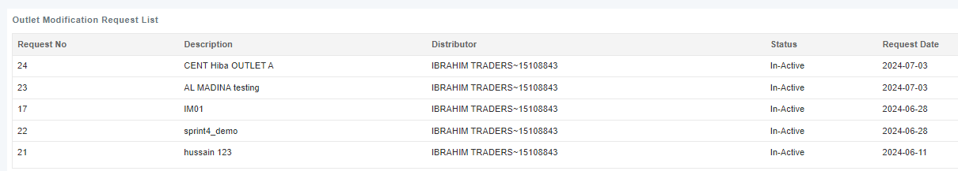
Change Track Outlet Profile
Modify Attributes
4
Modifying Outlet Attributes
To modify an outlet's attributes, follow these steps:
Select an Outlet: Click on the desired outlet from the list to view and edit its attributes.
Edit Attributes: Modify the necessary attributes of the selected outlet as needed.
Submit for Approval: Click the 'Forward for Approval' button to submit the modifications.
Review Changes: The generated request will appear in the grid above for review and approval.

Slide 16
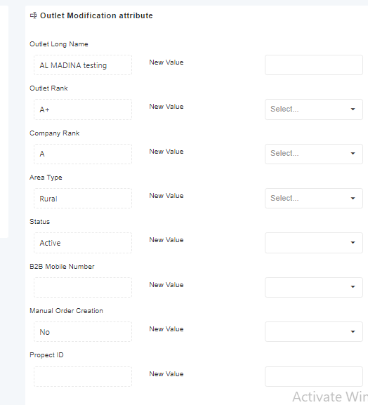

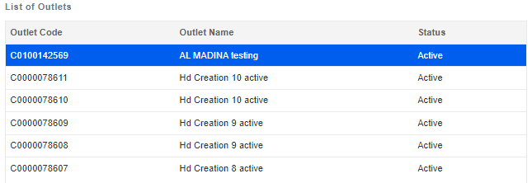
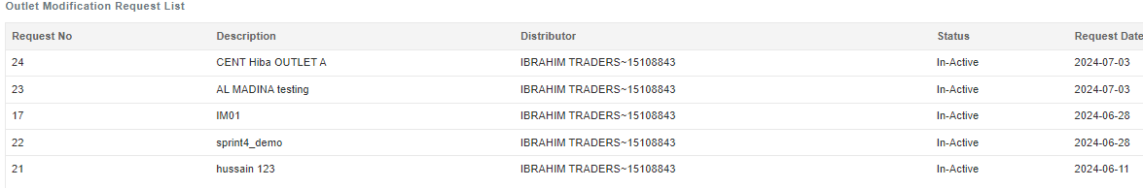
Change Track Outlet Operative Info
Modify Attributes of Operative Info
In this interface, users have the capability to modify specific attributes regarding operative info of approved outlets.
1
Search Change Track Outlet Operative Info in the search bar.
2
List of Outlets:
Upon accessing the screen, users will be presented with a comprehensive list of outlets. This list displays all currently approved outlets.
3
Field Descriptions:
Outlet Long Name: The full name of the outlet. Enter the new full name if any changes are required.
Outlet Rank: The rank of the outlet within the distribution network. Modify as needed.
Company Rank: The ranking of the outlet within the company's overall structure. Adjust if necessary.
Area Type: The classification of the area where the outlet is located. Update if applicable.
Status: The current operational status of the outlet. Change if required.
B2B Mobile Number: The business-to-business mobile contact number for the outlet. Update as needed.
Manual Order Creation: Indicates whether manual order creation is enabled for the outlet. Modify if necessary.
Prospect ID: The unique identifier for potential prospects related to the outlet. Update if applicable.
4
Modifying Outlet Attributes
To modify an outlet's attributes, follow these steps:
Select an Outlet: Click on the desired outlet from the list to view and edit its attributes.
Edit Attributes: Modify the necessary attributes of the selected outlet as needed.
Submit for Approval: Click the 'Forward for Approval' button to submit the modifications.
Review Changes: The generated request will appear in the grid above for review and approval.

Slide 17
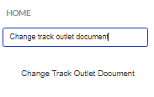
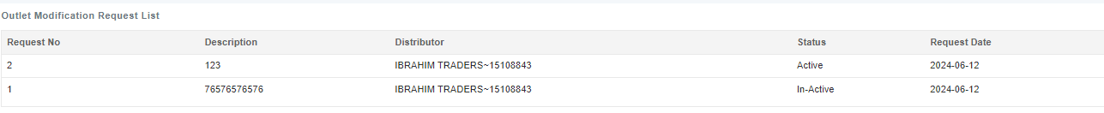
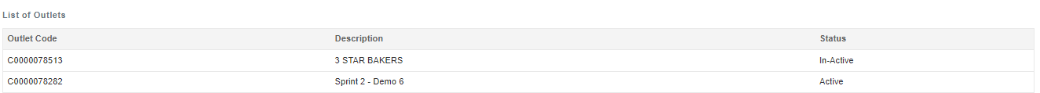
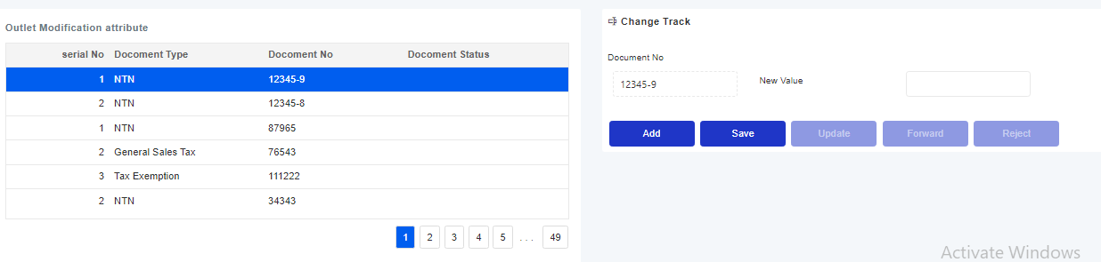
Change Track Outlet Document
Modify Attributes of Outlet Document
In this interface, users have the capability to modify documents of approved outlets.
1
Search Change Track Outlet Operative Info in the search bar.
2
The grid displays requests generated by users for document modifications.
3
List of Outlets
Upon accessing the screen, users will be presented with a comprehensive list of outlets. This list displays all currently approved outlets.
Modifying Outlet Attributes
To modify an outlet's attributes, follow these steps:
Select an Outlet: Click on the desired outlet from the list to view and edit its attributes.
Select the document: Click on the document from the list to edit its number.
Submit for Approval: Click the 'Forward for Approval' button to submit the modifications.
Review Changes: The generated request will appear in the grid above for review and approval.
4

Slide 18
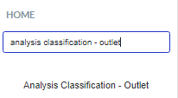
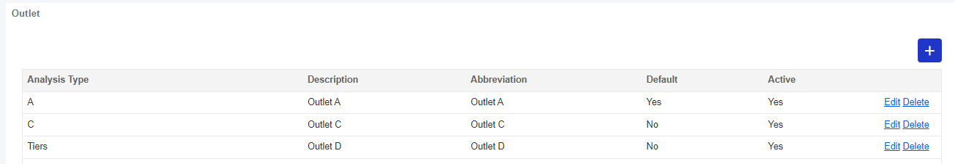
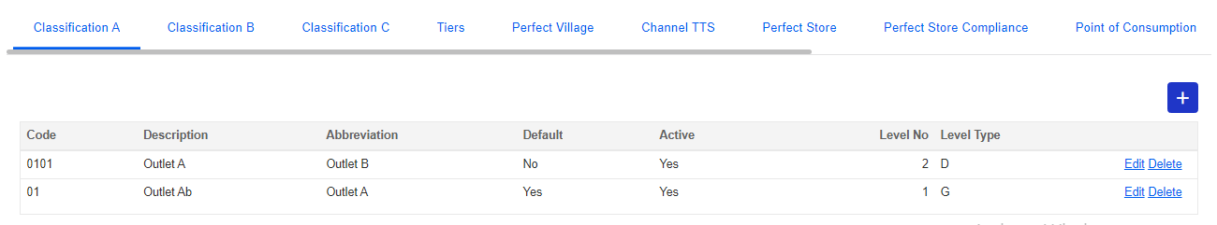
Analysis Classification Outlets
Classification Criteria
This interface categorizes outlets based on classification criteria, providing both grouped and detailed levels.
1
Search Analysis Classification Outlet in the search bar.
3
Steps to make any modifications:
Select Analysis Type: Click on any analysis type in the grid.
View Classification Details: The grid below displays outlet classifications with levels, offering both grouped and detailed views.
Editing: To make edits, click on the "Edit" button corresponding to the classification you wish to modify.
Saving Edits: After making amendments, click "Save."
Confirmation: A pop-up message will appear confirming that the changes have been saved successfully.
2
Users can view outlet categories segregated into different classifications on the below grid.

Slide 19
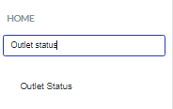
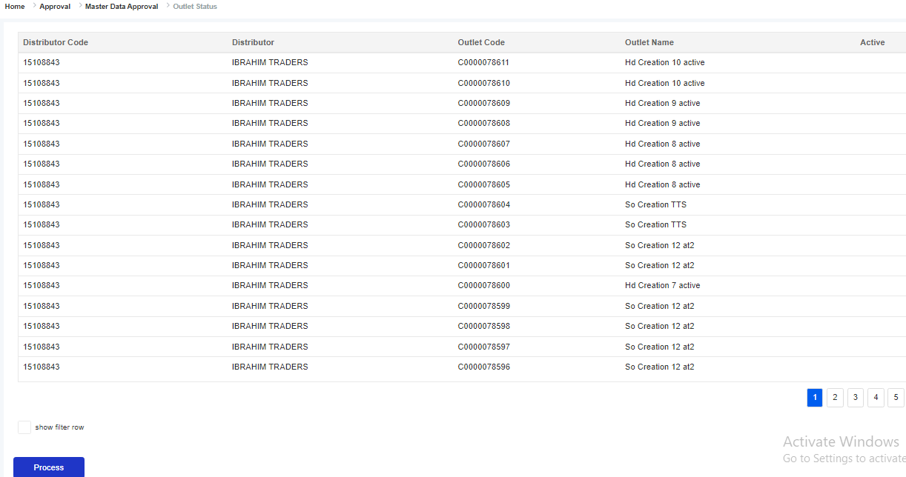
Outlet Status
Check Outlet Status
1
2
Search Outlet Status in the search bar.
Viewing Active Outlets
Users can see a list of all active outlets on the Outlet Status Screen.
3
4
Changing Outlet Status
Select Outlet: Click on the desired outlet from the list.
Initiate Process: Click on the "Process" button.
Confirmation: A confirmation pop-up will appear with the message, "Are you sure you want to proceed?" Click "Yes" to confirm.
Completion: A second pop-up will appear with the message, "Process completed successfully." The selected outlet will now be marked as inactive.
Verifying Inactive Outlets
Users can verify the status of inactive outlets by navigating to the Outlet Profile Screen, where the updated status will be displayed.

Slide 20
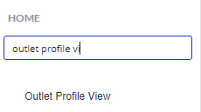
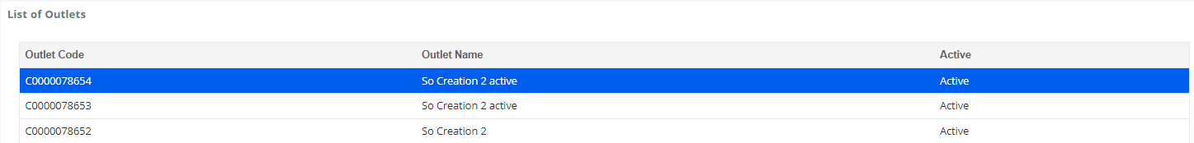
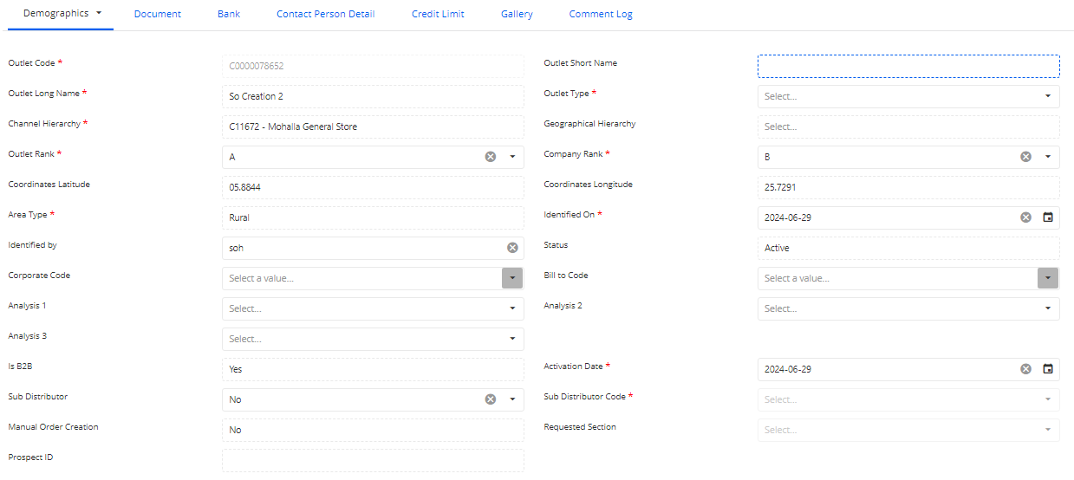
Outlet Profile View
View Outlets
From this screen, the user can only view the new and previous outlets information.
1
Search for the outlet profile view in the search bar and click on the appeared option.
2
The grid displays the new and previously created outlets information. The user can click on the desired entry to view further information.
3
After selecting any existing record, the relevant information related to the selected outlet will be displayed in the fields below. The user can only view the information.

Slide 21
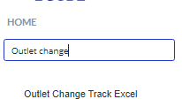
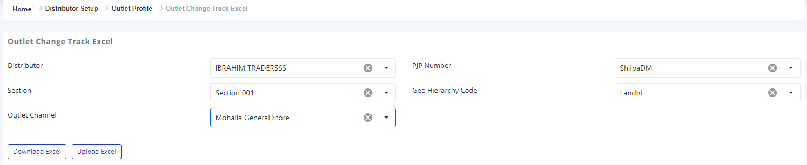
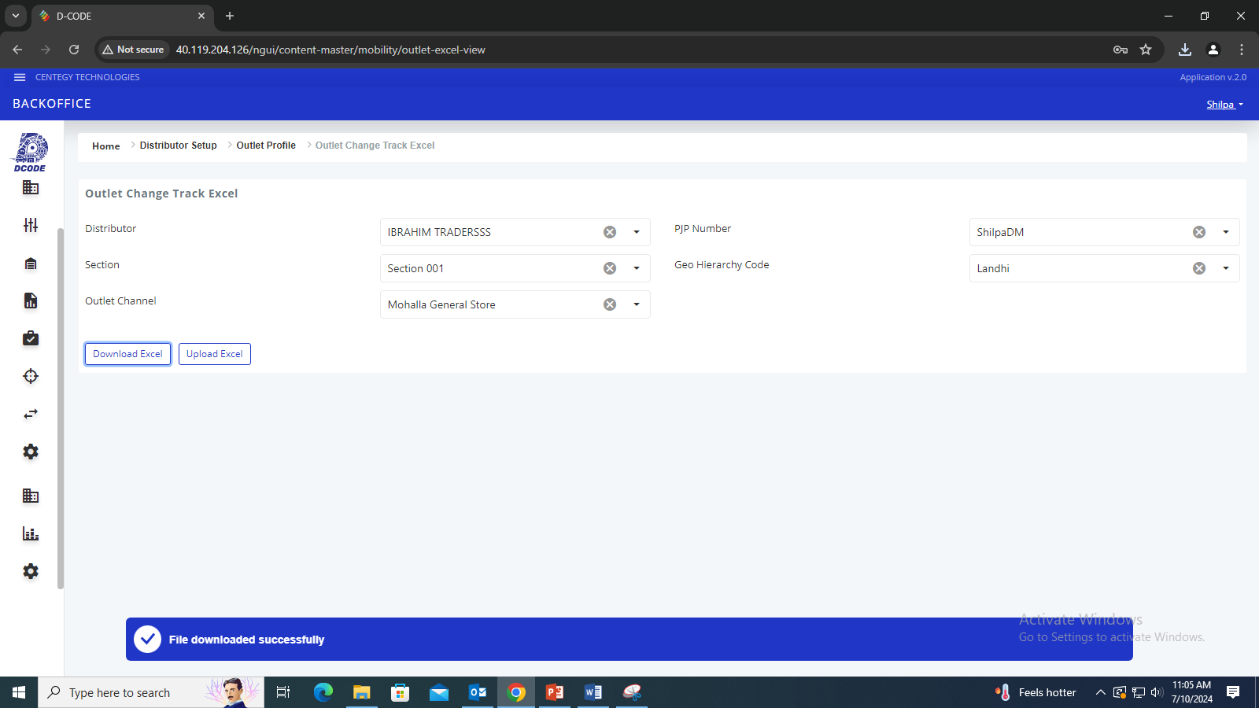
Outlet Change Track Excel
Bulk Outlets Modifications
This screen allows the user to efficiently update outlet attributes in bulk through an excel upload.
1
2
Search for the outlet change track excel in the search bar and click on the appeared option.
The user will select the relevant parameters from the dropdown to be able to download the excel file template.
3
Dropdown Filters Description
Distributor: The user will select the distributor to filter and display outlets that are linked specifically to that distributor.
PJP Number: Select the PJP number that will be associated with the selected distributor.
Section: Select the section from the dropdown.
Geo Hierarchy Code: Select geo hierarchy code from the dropdown.
Outlet Channel: Select the channel of outlet from the dropdown.
5
4
Click the Download Excel button to download the excel file which contains the outlets and their associated attributes.
After downloading the file, the user will do modifications in the excel file and then utilize the Upload Excel button to upload the outlets information.
The system prompts the message “File Downloaded Successfully”.
Important: Once the uploading process will be done, the updated outlet information will be displayed on the grid within the outlet profile interface.

Slide 22
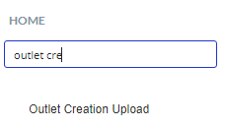
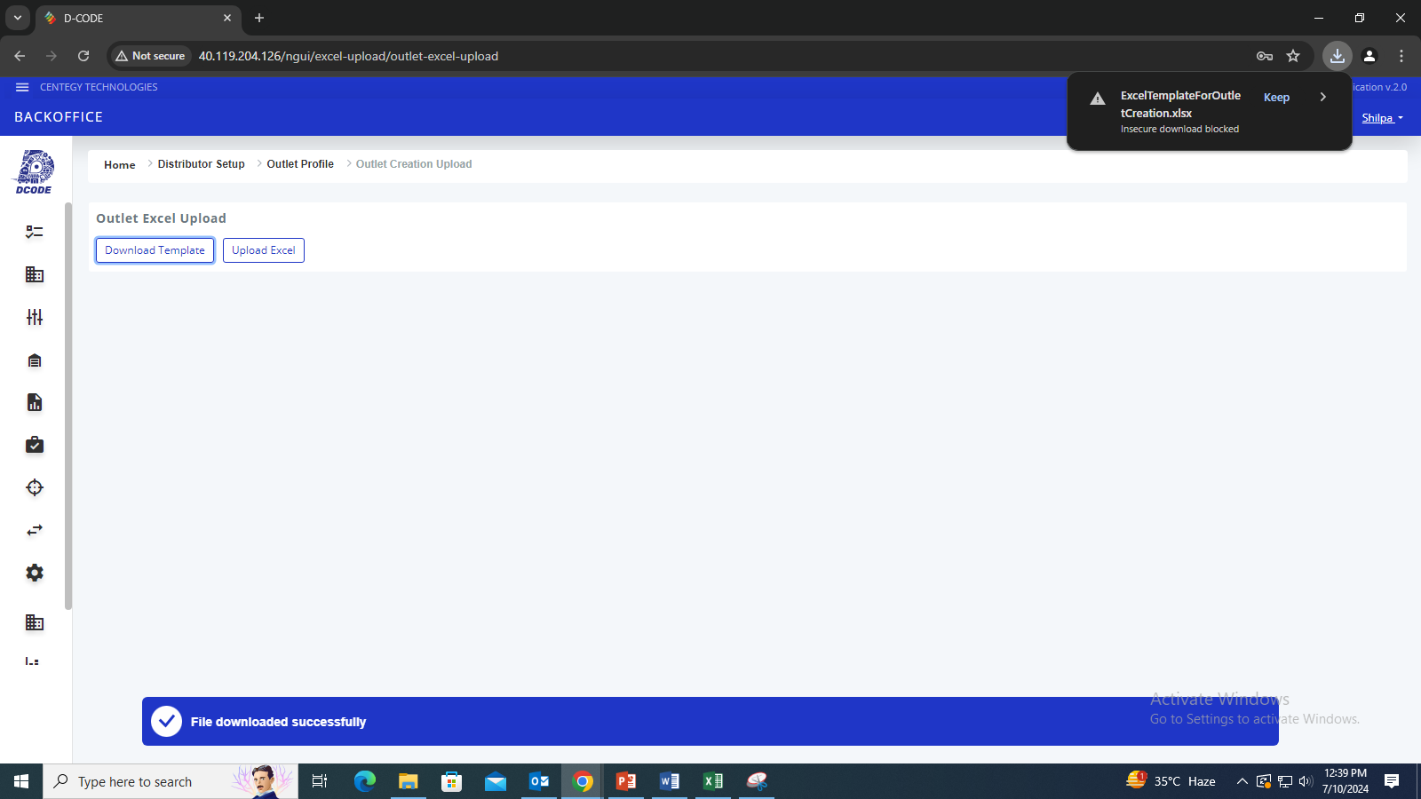
Outlet Creation Upload
New Outlets Bulk Upload
From this screen, the user can create new outlets in bulk using the provided excel template and the upload functionality. This method ensures accurate creation of multiple outlets.
1
Search for the outlet creation upload in the search bar and click on the appeared option.
2
The system prompts the message “File Downloaded Successfully”.
2
The user will click the Download Template button to download the excel file template.
The downloaded template will be then uploaded from the Upload Excel button after filling out the outlets information.
3
This is the downloaded excel template with the relevant attribute names pertaining to the outlets. The user will input the multiple new outlets information and save the excel file in the desired system’s location.
Important: Once the uploading process will be done, the user can view the newly created outlets on the grid within the outlet profile interface.

Slide 23
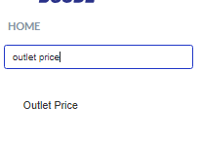
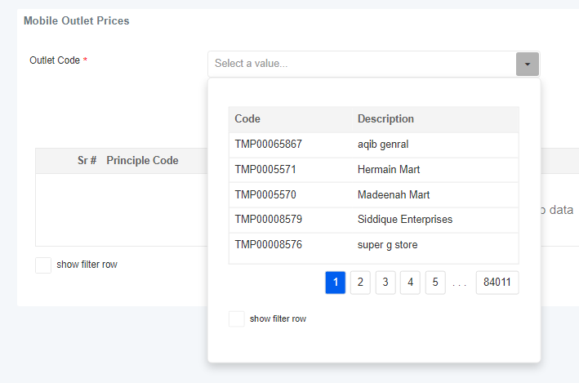
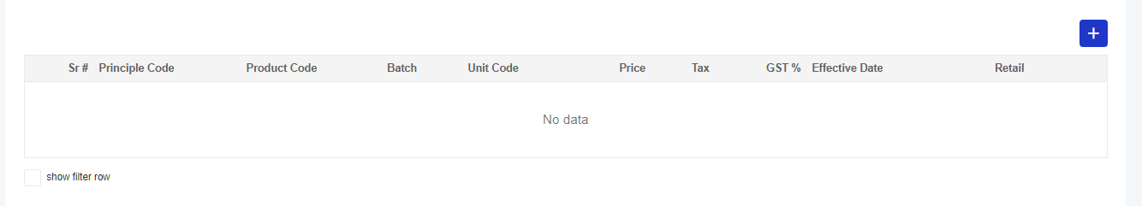
Outlet Price
Adding Prices
The Outlet Price interface allows users to efficiently manage product pricing for outlets.
2
Select outlet from the dropdown menu
1
Search Outlet Price in the search bar.
3
Users can input and set prices for products sold at various outlets. Prices can be integrated across the system for consistency and accuracy Additionally, Users can access and review prices of products for already existing outlets, ensuring easy updates and comparisons.

Slide 24
  Glossary
B2B
Business to Business
DT
Distributor
PJP
Permanent Journey Plan
Back
Next

Slide 25
  Final Thoughts
Following are the key takeaways from this document:
The Outlet Master is an integral component of the Distributor Management System, designed to streamline and enhance outlet management processes.
Outlet Approval II streamlines the approval process, ensuring outlet profiles meet necessary standards.
Change Track Outlet Profile & Operative Info allows for precise modifications to outlet attributes and operational details.
Outlet Status & Document Management facilitates status checks and document updates to maintain outlet compliance.
Outlet Profile & Price Management enables the creation of comprehensive outlet profiles and accurate pricing information.
Analysis Classification-Outlets provides robust categorization for in-depth analysis and reporting.
Outlet Profile View ensures easy access to detailed outlet profiles.
Outlet Change Track Excel supports accurate and efficient modifications of outlet data in Excel format.
Through detailed interfaces, users can efficiently manage various aspects of outlet operations.
www.centegytechnologies.com
contact@centegytechnologies.com

